Slide 1
The Impact of ICTs and AI on Power Structures
Amro Emad Hassan Askar (946807)
Aly Maged Mohamed Mohamed Sayed Ahmed (946984)
Li Hao (947013)

Slide 2
Concepts
Political Marketization
  Definition
  The Tech Factor
  Clarification
Data Sovereignty
  From Physical to Computational
  Security Concerns
Techno-Protectionism
  Weaponized Nodes
  Regionalization

Slide 3
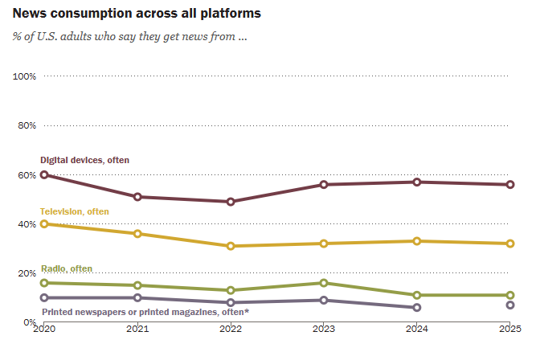
Historical Evolution
Phase 1: From newspaper to Television
  Print Era: "Age of Exposition"—defined by logic, depth, and elite diplomacy.
  Television Era: "Age of Show Business" (Neil Postman).
  Domestic: Politics becomes image-driven, emotive, and soundbite-heavy (e.g., MAGA).
  International: The rise of Soft Power and Public Diplomacy. Winning the "hearts and minds" via global broadcasting.
  The CNN Effect: Real-time imagery forcing government responses.
Phase 2: From Television to AI/Big Data
  Computational Propaganda: Use of bots, algorithms, and automated scripts to manipulate content.
  Micro-targeting: Shifting from "Mass Broadcasting" to "One-on-One Precision Retail.“
  Hidden Influence: LLMs (like ChatGPT) influencing political orientation through training data bias.
  New Reality: Whoever owns the tech power owns the "Retail Market" of human cognition.

Slide 4
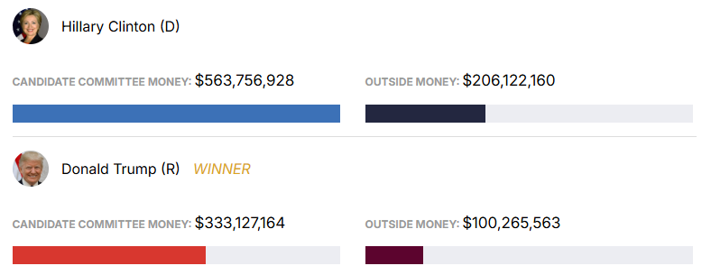
Case Study: US Domestic Politics (2016-2024)
Tech vs. Tradition
"Media Attention" as a commodity
The "Megaphone Effect": Political bots and AI-driven echo chambers creating massive organic reach.
Conclusion: Success was not just about strategy, but about adopting a superior media technology.

Slide 5
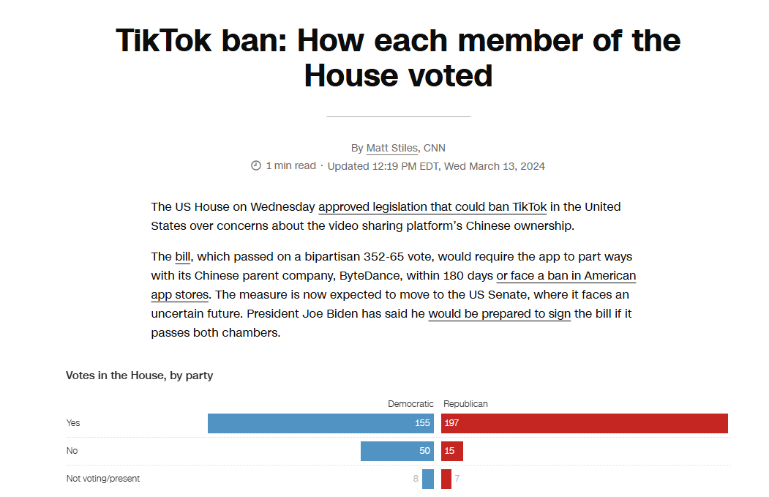
Case Study 2: US-China Tech Rivalry
TikTok
  TikTok as a Catalyst: More than an app—it is a "High-Efficiency Perception Distribution System.“
  Sovereignty Conflict: US fear of "Foreign Algorithmic Manipulation" over its domestic political market.
  Policy Response: The forced divestiture is a clear act of Digital Sovereignty Protection, not just a market action. (352-62)

Slide 6
The Paradox of Technological Progress
The Paradox: Tech has the potential to connect the world, yet its impact on power forces nations to disconnect.
Reason
  1. Tech makes domestic politics fragile (Marketization).
  2. Fragility leads to fear of foreign interference.
  3. Fear triggers defensive barriers (Regionalization).
Conclusion and Clarification

Slide 7
Thanks
Do you have any questions?
Please keep this slide for attribution

Slide 8
To Claim Methodologies
Generative AI is used to search data, assist brainstorm, and recapitulate the content
Article searching platform (Prometeo) is used to search the articles and references
Translator is used to help write the report
Group discussion
Pdf template platform

